Slide 1
Error mitigation
How to correct the errors that comes from measurement ?

Slide 2


Measurement errors on quantum systems : the model
Model : noise is introduced after the measurement is made
Reality : noise is introduced because of the measurement
Solution : compose the noisy bitstring with a matrix to mitigate the errors

Slide 3
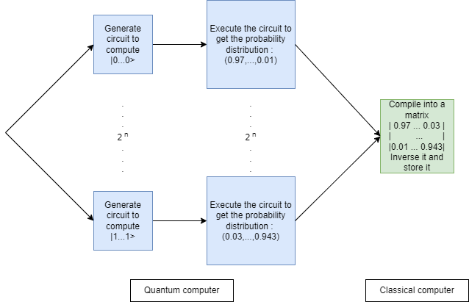
Computing the error mitigation matrix

Slide 4


Mitigate the measurement errors of another circuit
$$C_{noisy}=C_{ideal} ∗M$$
$$↔C_{noisy} ∗M^{−1}=C_{ideal}$$
How Qiskit inverse the matrix :
- pseudo-inverse
- least square inverse

Slide 5

Demonstration
The notebook for the demonstration is available here : https://ibm.box.com/s/x15t8jacm6c9ueh92lga3ekh0hl5q5q4

Slide 6
Conclusion
The notebook for the comparaison is available here :
https://ibm.box.com/s/rylc5udbklnsgt0twn280x6w3o42tizc

Slide 7

Questions ?

